Slide 1
Course : T7043 – IT Services
Period : February 2018
Configuration and Asset Management
Session 7
D5664 – Dr. Eng. Antoni Wibowo

Slide 2
CONFIGURATION MANAGEMENT
CONFIGURATION MANAGEMENT is a process to ensure that the interrelationships of varying version of infrastructure hardware and software are documented accurately and efficiently.
Bina Nusantara

Slide 3
CONFIGURATION MANAGEMENT
Function

Slide 4
CM & Service Management
Configuration Management is at the core of effective service management within an organization. And although there are many elements to the provision of good service management, it is Configuration Management that provides the glue, the adhesive that bonds good service into supporting the business’s processes.
The move from ITIL V2 to ITIL V3 has transitioned IT from a systems management perspective to one of “service” management. This requires a change in mindset from an IT technology view to a business process view. The new version places the emphasis on managing business and IT services using a lifecycle approach (i.e. from planning to disposal), and this brings the ITIL CMDB more into the enterprise architecture arena.
Bina Nusantara

Slide 5
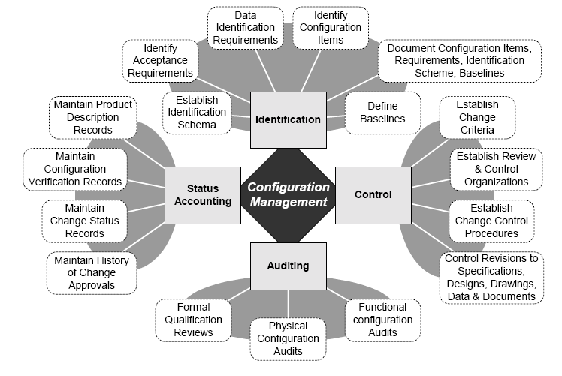
Fungsi CM
Bina Nusantara

Slide 6
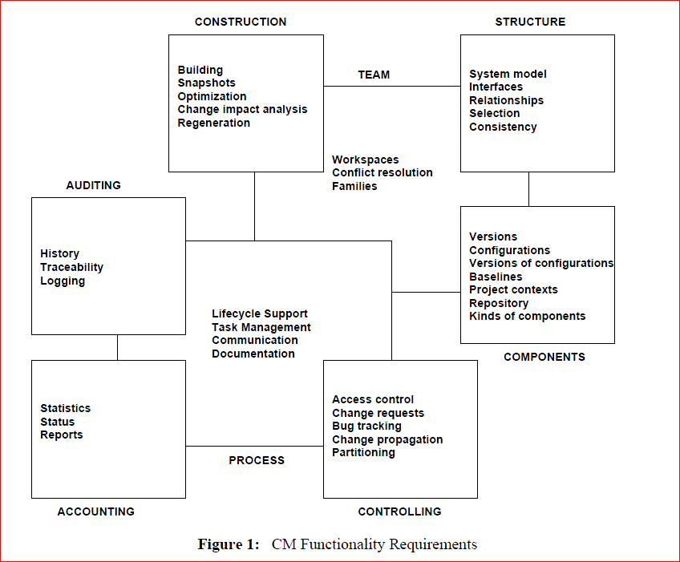
CM fuctionality Requirement
Bina Nusantara

Slide 7
CONFIGURATION MANAGEMENT
Process

Slide 8
Process -CM
The Configuration Management process is designed to collect and maintain information about the organization’s IT infrastructure. Once harnessed, its insights into the infrastructure are numerous. Configuration Management improves a company’s control over its IT assets, and in the long run, implementing the process saves money for the business.
Bina Nusantara

Slide 9
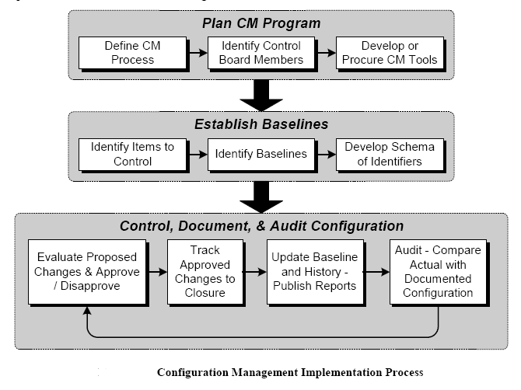
CM-Implementation Process
Bina Nusantara

Slide 10
Ten Key Roles
Best Practice
Configuration Management

Slide 11
Ten Key Roles for ITIL Configuration
Management Best Practice
1. Configuration Management Architect — You need one strong technical leader who can be counted on as the expert in Configuration Management.
2. Requirements Analyst — You do have Configuration Management requirements, don’t you? This person will help you determine all the requirements needed to configure the environment.
3. Process Engineer – This may be more important at the onset, but Version 3 of ITIL calls for continuous process improvement.
Bina Nusantara

Slide 12
Ten Key Roles for ITIL Configuration Management Best Practice
4. Logical DBA — Configuration Management is all about gathering, controlling, and accessing information; of course you need a DBA.
5. Trainer — Someone will need to create training materials and instruct all of your IT staff in how to access and support Configuration Management.
6. CM Integrator — Every CMDB is built from data stored across many sources. The integrator role supervises the reconciliation rules that bring those sources together.
7. Tools Support — Eventually, your entire IT staff will depend on information in the CMDB, and thus on the availability of the tools.

Slide 13
Ten Key Roles for ITIL Configuration Management Best Practice
8. Impact Manager — This role specifically focuses on helping make configuration data intelligible to the rest of the IT organization. The key task here is to make sure relationships between configuration items are well defined, helpful, and accurate.
9. Reporting Support — Because the CMDB is a database, many users will want to create custom queries and specialized reports. Someone who understands the data deeply will help make this possible.
10. Data Quality Analyst — ITIL rightly points out that the best practice in Configuration Management is to constantly verify data and audit the database.
Bina Nusantara

Slide 14
Practical Tips for Improving Configuration Management

Slide 15
Practical Tips for Improving Configuration Management
Select Qualified process owner
Acquire the assistance of a technical writer or documentation analyst
Match the backgrounds of writers to technicians
Evaluate the quality and value of existing configuration documentation
Involve appropriate hardware suppliers
Involve appropriate software suppliers
Coordinate documentation efforts in advance of mayor hardware and software upgrades
Involve the asset-management group for desktop equipment inventories.
Bina Nusantara

Slide 16
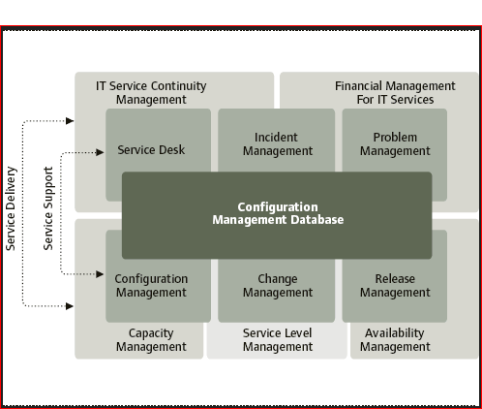
Bina Nusantara

Slide 17
Configuration Management
and
Asset Management

Slide 18
Configuration and Asset Management
Configuration management is the process of:
identifying configuration items (components of systems and subsystems)
managing information about the configuration items (attributes and relationships) in a configuration management database (CMDB)
controlling the CMDB by ensuring the accuracy of configuration item (CI) attributes and relationships, and by updating the CMBD to reflect changes to Cis
providing status monitoring of the CMDB to ensure that CIs are tracked in accordance with their life cycle stage (planned/ordered, received, tested, operational, retired)
verifying CIs by auditing the CMDB against actual configurations and the change management history
Bina Nusantara

Slide 19
Configuration and Asset Management
Asset management is a process that focuses on accounting.
The main goals of asset management are:
identifying asset custody
managing the financial life cycle of an asset, including acquisition costs, depreciation and retirement/disposal
verifying the physical location and condition of an asset through audits
Bina Nusantara

Slide 20
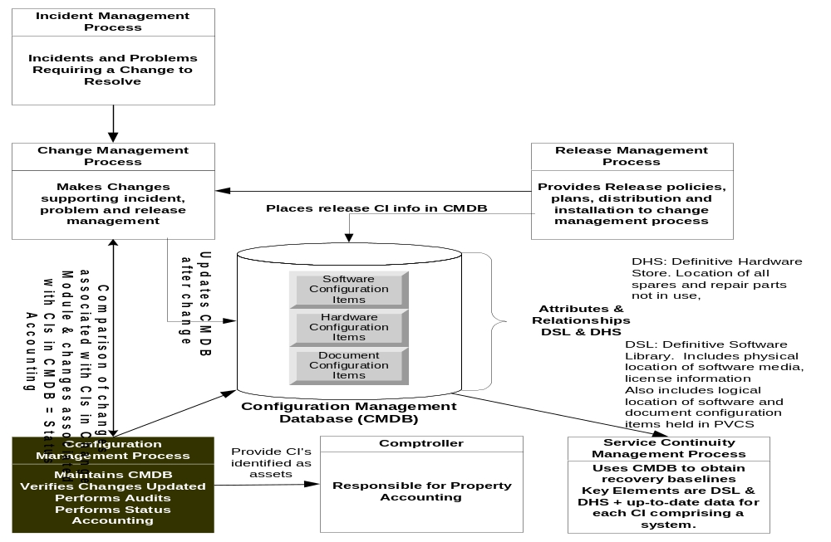
Bina Nusantara

